Slide 1
Printable Programming Transformations

Slide 2
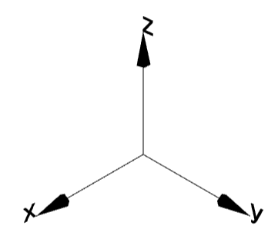
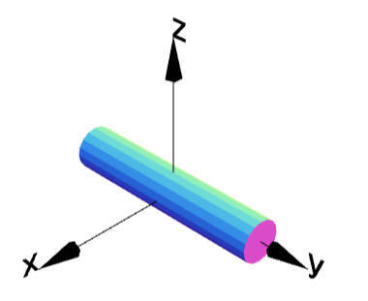
Axis
g = cylinder(0.1,1);
g.display();

Slide 3
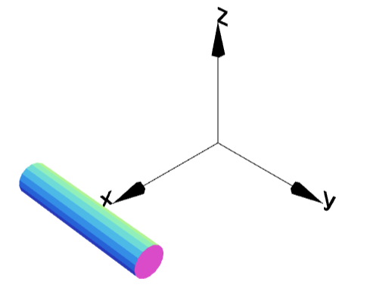
MoveX
g = cylinder(0.1,1);
g.moveX(1);
g.display();

Slide 4
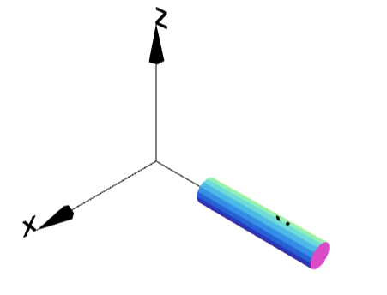
MoveY
g = cylinder(0.1,1);
g.moveY(1);
g.display();

Slide 5
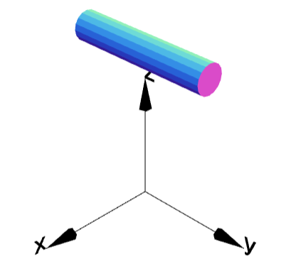
MoveZ
g = cylinder(0.1,1);
g.moveZ(1);
g.display();

Slide 6
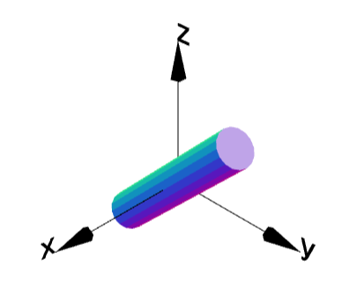
RotateX
g = cylinder(0.1,1);
g.rotateX(45);
g.display();

Slide 7
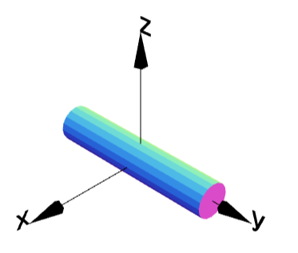
RotateY
g = cylinder(0.1,1);
g.rotateY(45);
g.display();

Slide 8
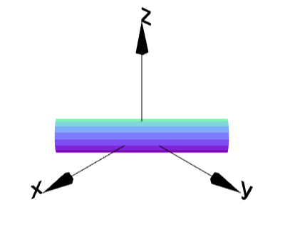
RotateZ
g = cylinder(0.1,1);
g.rotateZ(45);
g.display();

Slide 9
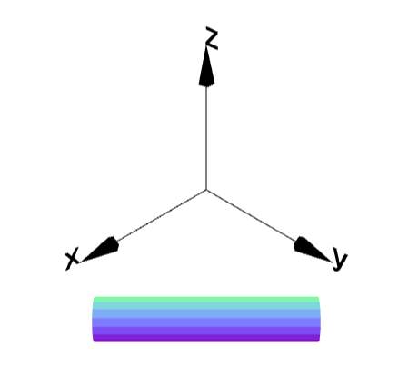
Multiple Transformations
g = cylinder(0.1,1);
g.moveX(1);
g.rotateZ(45);
g.display();

Slide 10
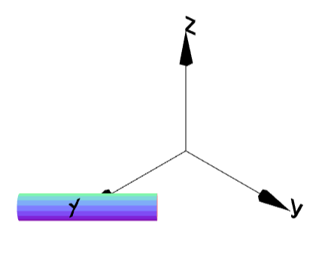
Multiple Transformations
g = cylinder(0.1,1);
g.rotateZ(45);
g.moveX(1);
g.display();
Order of transformation matters.

Slide 11
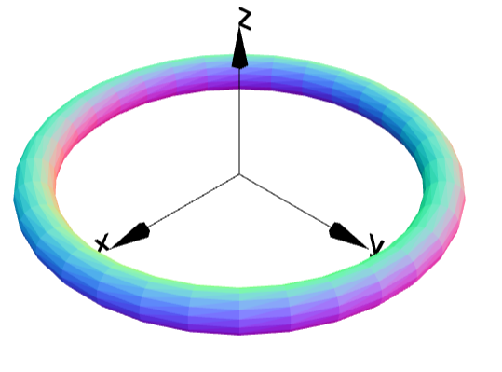
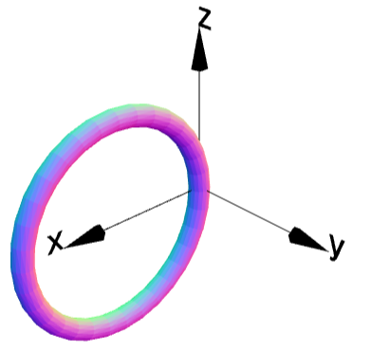
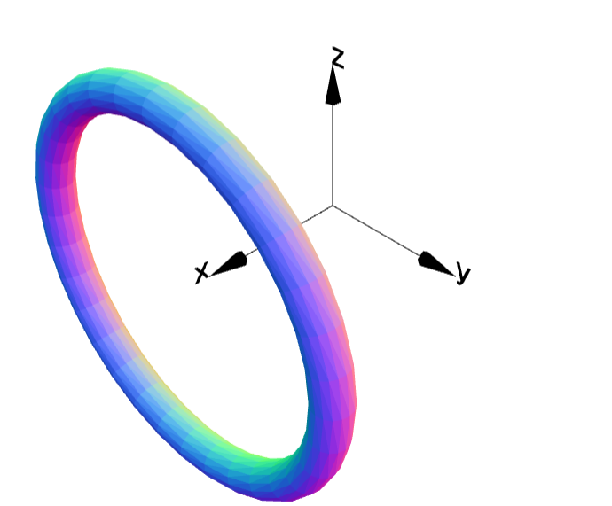
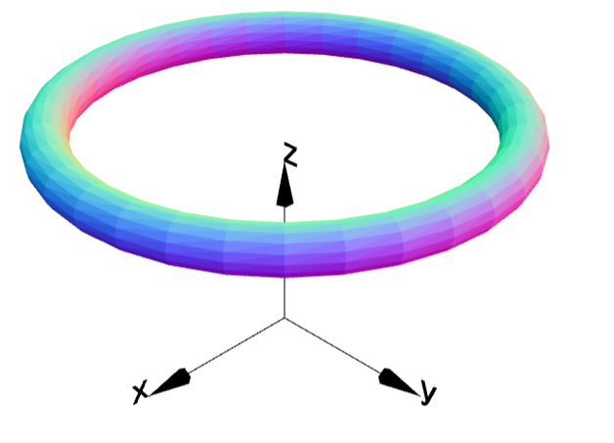
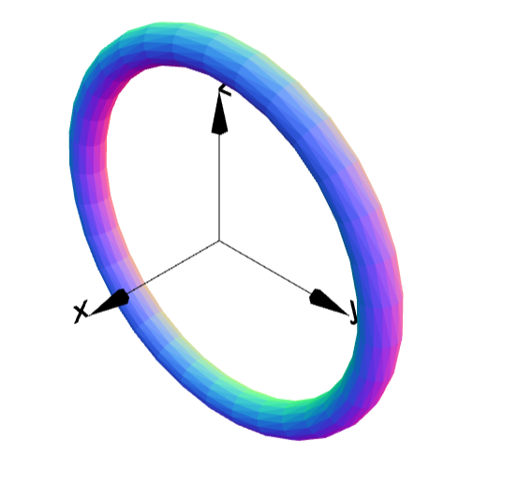
Torus Transformations
g = torus(1,0.1);
g.display();
1
2
3
4

