Slide 1
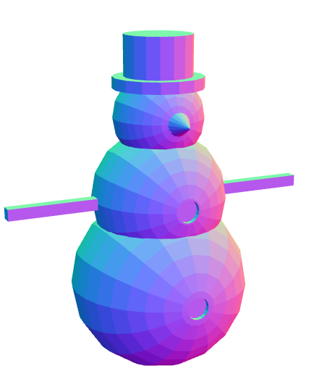
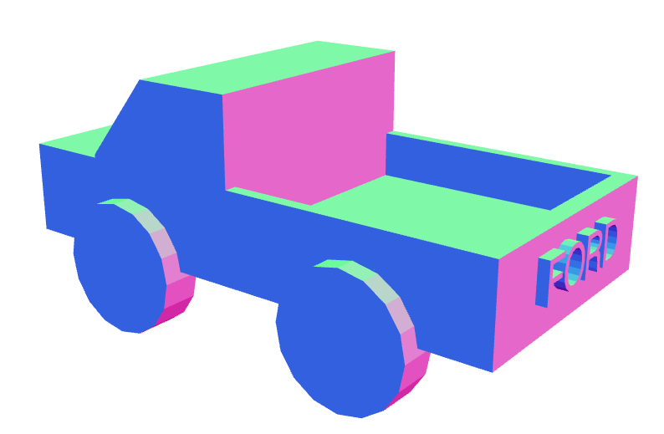
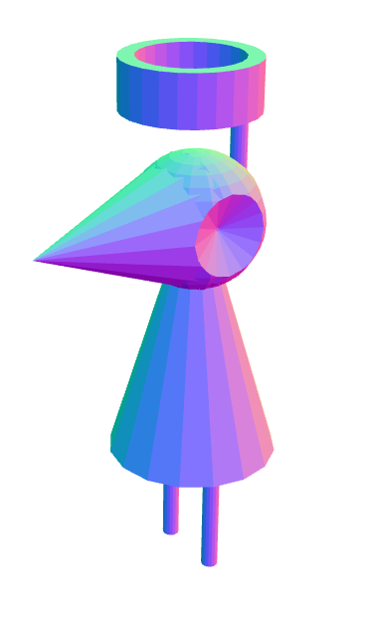
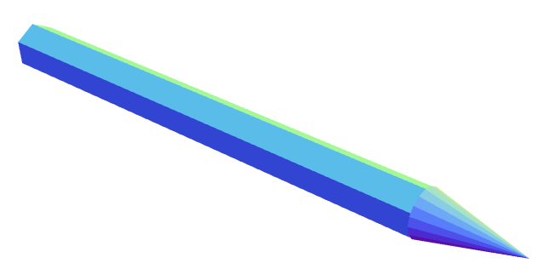
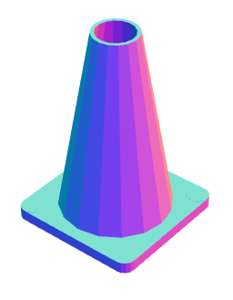
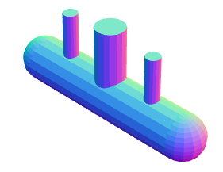
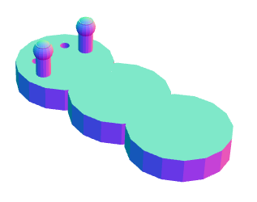

Slide 2
SnowMan
g1=sphere(40);
g2=sphere(30).translate(0,0,40);
g3=sphere(20).translate(0,0,75);
g4=cylinder(20,5).rotateX(90).translate(0,0,90);
g5=cylinder(15,20).rotateX(90).translate(0,0,100);
g6=cone(5,0.1,10).translate(0,25,75);
g7=cylinder(5,5).translate(0,40,0);
g8=cylinder(5,5).translate(0,30,40);
g9=cube(40,5,5).translate(50,0,40);
g10=cube(40,5,5).translate(-50,0,40);
g1=g1.union(g2).union(g3).union(g4).union(g5).union(g6).difference(g7).difference(g8).union(g9).union(g10);
g1.display();

Slide 3
Truck
body1 = cube(4,2,0.7);
body2 = cube(1.3,2,1).translate(0.7,0,0.5).union(body1);
car = body2.difference(cube(0.5,3,2).rotateY(-40).translate(0.9,0,1.3));
wheel = cylinder(0.5,0.3).translate(1,1,-0.4);
wheel2 = wheel.clone().translateX(-2);
wheel3 = wheel2.clone().translatey(-2);
wheel4 = wheel3.clone().translateX(2);
bed = cube(1.9,1.8,2).translate(-0.9,0,1);
car = car.union(wheel4).union(wheel3).union(wheel2).union(wheel);
car = car.difference(bed);
ford = textgeom("FORD",0.3,0.08).rotateX(90).rotateZ(90).translate(2,-0.5,-0.1).rotateZ(180);
car = car.union(ford);
car.display();

Slide 4
Alien
h1=cone(4,0.01,10).rotateX(90).translate(0,0,1.6);
h2=sphere(4).translate(0,0,-4);
h3=cone(4,0.1,2).rotateZ(90).translate(3,0,-4);
h4=cone(4,0.1,2).rotateZ(270).translate(-3,0,-4);
h2=h2.union(h1);
h2=h2.difference(h3).difference(h4);
pole=cylinder(0.5,8).translate(0,3,-7);
h2=h2.union(pole);
c1=cylinder(4,3,25).translate(0,8,-3.5).difference(cylinder(3.05,3,25).translate(0,8,-3.5));
h2=h2.union(c1);
body=cone(5,0.5,15).translate(0,-7,-4);
h2=h2.union(body);
leg=cylinder(0.5,10).translate(-2,-17,-4);
h2=h2.union(leg);
leg.clone();
leg.translate(4,0,0);
h2=h2.union(leg);
h2.rotateX(90);
h2.display();

Slide 5
Submarine
c1 = cylinder(7.5,60).rotateX(90);
c2 = cylinder(5,25).translate(0,12.5,0);
c3 = cylinder(2.5,20).translate(0,12.5,17.5);
c4 = cylinder(2.5,20).translate(0,12.5,-17.5);
s1= sphere(7.5).translate(0,0,30);
s2= sphere(7.5).translate(0,0,-30);
sub = s1.union(s2).union(c1).union(c2).union(c3).union(c4);
sub.rotateX(90);
sub.display();

Slide 6
Pencil
pencilpoint= cone(9.8, 0.1, 40);
pencilbody=cylinder(10,200,6).translateY(-120);
pencil=pencilbody.union(pencilpoint);
pencil.display();

Slide 7
Traffic Cone
e1 = cube(2.5,3,0.25).union(cube(3,2.5,0.25));
e2 = cylinder(0.25,0.26).rotateX(90).translate(-1.25,1.25,0);
e2 = e2.union(e2.clone().translate(2.5,0,0));
e2 = e2.union(e2.clone().translate(0,-2.5,0));
e1 = e1.union(e2);
e1 = e1.difference(e1.clone().scale(0.83,0.83,0.5).translate(0,0,-0.125));
e1 = e1.union(cone(1.25,0.5,4.25).rotateX(90).translate(0,0,2.125));
e1 = e1.difference(cone(1.18,0.405,4.376).rotateX(90).translate(0,0,2.125));
e1.display();

Slide 8
Coffee Mug
mainmug= cylinder(10,20).union(torus(4.5,1.2).translateX(10.5));
mughole=cylinder(8.5,30).translateY(-1.5);
mainmug =mainmug.difference(mughole);
mainmug.rotateX(-90);
mainmug.display();

Slide 9
Bug
cyl1 = cylinder(10,5);
cyl2 = cyl1.clone().translateZ(-15);
cyl3 = cyl1.clone().translateZ(-30);
body = cyl1.union(cyl2).union(cyl3);
eye1 = cylinder(1,4).translate(4,0.5,4);
eye2 = eye1.clone().translateX(-8);
body = body.difference(eye1).difference(eye2);
ant1 = cylinder(1.5,7).union(sphere(2).translateY(2));
ant1 = ant1.translate(6,6,0);
ant2 = ant1.clone().translateX(-12);
body = body.union(ant1).union(ant2);
body = body.rotateX(90);
body.display();

