Slide 1
<Name of Project>
Your Name
This is a sample project template. Change the contents to suit your needs.

Slide 2
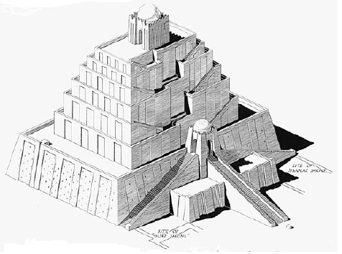
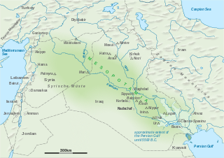
A Ziggurat is an Ancient Religious Structure
Found in Mesopotamia
Made of brick
Religious purposes

Slide 3
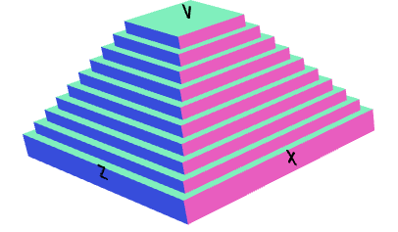
Coding the Main Body
Ziggurat=cube(100,10,100);
for(i=1;i<=9;i=i+1)
{
stairs=cube(100-7.5*i,10,100-7.5*i).move(0,i*5,0);
Ziggurat = Ziggurat.add(stairs);
}
Simple for loop
Made the stacking boxes

Slide 4
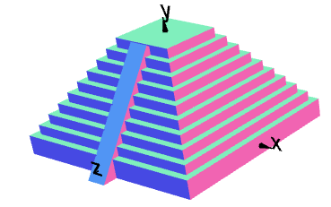
Coding the Stairway
strairStrip=cube(10,117,10).rotateX(-36).move(0,0,48);
g3=cube(200,100,200).move(0,-55,0);
strairStrip=strairStrip.subtract(g3);
Ziggurat = Ziggurat.add(strairStrip);
The stair strip
2 Booleans used

Slide 5
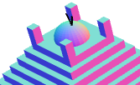
Coding the Top
//Top portion
topSphere=sphere(10).move(0,50,0);
Ziggurat = Ziggurat.add(topSphere)
topPillar1=cube(5,10,5).move(13.75,55,13.75);
topPillar2=cube(5,10,5).move(13.75,55,-13.75);
topPillar3=cube(5,10,5).move(-13.75,55,-13.75);
topPillar4=cube(5,10,5).move(-13.75,55,13.75);
Ziggurat = Ziggurat.add(topPillar1).add(topPillar2);
Ziggurat = Ziggurat. add(topPillar3).add(topPillar4);
Last fancy additions to the top
Simple Cubes and a sphere

Slide 6
Final Code
Ziggurat=cube(100,10,100);
for(i=1;i<=9;i=i+1)
{
stairs=cube(100-7.5*i,10,100-7.5*i).move(0,i*5,0);
Ziggurat=Ziggurat.add(stairs);
}
strairStrip=cube(10,117,10).rotateX(-36).move(0,0,48);
g3=cube(200,100,200).move(0,-55,0);
strairStrip=strairStrip.subtract(g3);
Ziggurat=Ziggurat.add(strairStrip);
topSphere=sphere(10).move(0,50,0);
Ziggurat=Ziggurat.add(topSphere)
topPillar1=cube(5,10,5).move(13.75,55,13.75);
topPillar2=cube(5,10,5).move(13.75,55,-13.75);
topPillar3=cube(5,10,5).move(-13.75,55,-13.75);
topPillar4=cube(5,10,5).move(-13.75,55,13.75);
Ziggurat=Ziggurat.add(topPillar1).add(topPillar2);
Ziggurat=Ziggurat.add(topPillar3).add(topPillar4);
Ziggurat.rotateX(90).rotateZ(90);
Ziggurat.display();

Slide 7
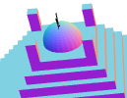
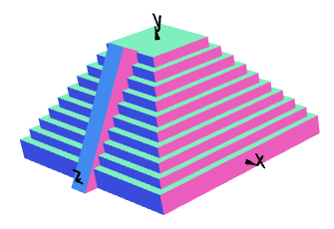
Difficulties
The 4 cube’s placement
Staircase Alignment

