Slide 1
Printable Programming For Loops

Slide 2
‘for’ loop
resetBeeper();
for (i = 1; i <= 4; i= i+1){
beep();
}
How many beeps?
i = 1, 2, 3, 4

Slide 3
‘for’ loop
 | resetBeeper(); for (i = 1; i <= 4; i= i+1){ beep(); } | i = 1, 2, 3, 4 | 4 beeps
1 | for (i = 1; i <= 6; i= i+1){
2 | for (i = 1; i < 6; i= i+1){
3 | for (i = 0; i <= 4; i= i+1){
4 | for (i = -1; i <= 4; i= i+1){
5 | for (i = 1; i <= 4; i= i+2){
6 | for (i = 4; i >1; i= i-1){
7 | for (i = 10; i > 4; i= i-1){

Slide 4
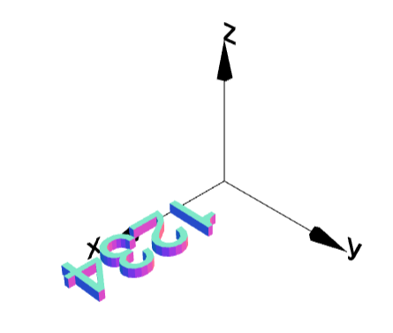
‘for’ loop with textGeom
for (i = 1; i <= 4; i = i+1){
g = textGeom(i)
g.moveX(20*i);
g.display();
}
Play around with the code.

Slide 5
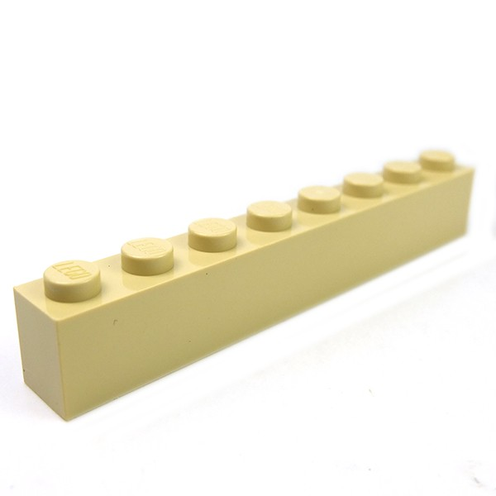
A Lego piece

Slide 6
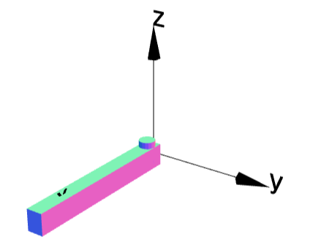
A Lego piece: Step 1
L = 16;
W = 1.5;
H = 2;
R = 0.75;
HCyl = 2.2;
base = cube(L,W,H).moveX(L/2);
cyl1 = cylinder(R,HCyl).rotateX(90);
cyl1.moveZ(H/4);
cyl1.moveX(L/16);
base =base.add(cyl1);
base.display();

Slide 7
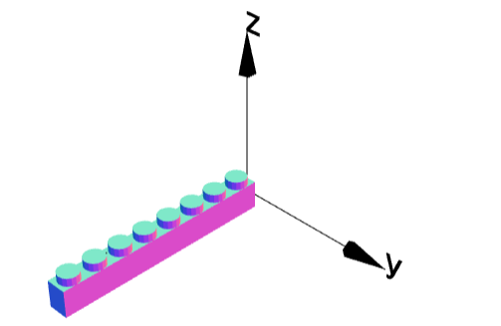
A Lego piece: Step 2
L = 16;
W = 1.5;
H = 2;
R = 0.75;
HCyl = 2.2;
base = cube(L,W,H).moveX(L/2);
cyl1 = cylinder(R,HCyl).rotateX(90);
cyl1.moveZ(H/4);
cyl1.moveX(L/16);// position first object
for (i = 1; i <= 8; i= i+1) {// start for loop
base =base.add(cyl1);// add
cyl1.moveX(L/8);// then move
}
base.display();

Slide 8
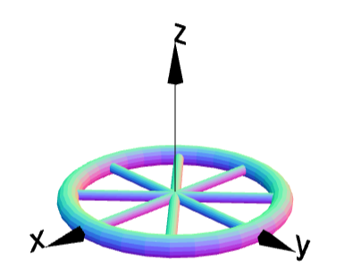
Wheel
wheel = torus(1,0.1);
spoke1 = cylinder(0.05,2);
spoke2 = cylinder(0.05,2).rotateZ(45);
spoke3 = cylinder(0.05,2).rotateZ(90);
spoke4 = cylinder(0.05,2).rotateZ(135);
wheel = wheel.add(spoke1);
wheel = wheel.add(spoke2);
wheel = wheel.add(spoke3);
wheel = wheel.add(spoke4);
wheel.display();
Redo using for-loop.

Slide 9
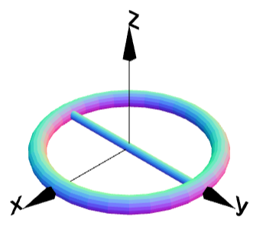
Wheel: Step 1
wheel = torus(1,0.1);
spoke = cylinder(0.05,2);
wheel = wheel.add(spoke);
wheel.display();

Slide 10
Wheel
wheel = torus(1,0.1);
spoke = cylinder(0.05,2);// position first object
for (i=1; i<=4; i=i+1){// start for loop
wheel = wheel.add(spoke);// add
wheel.rotateZ(45);// then rotate
}
wheel.display();

Slide 11
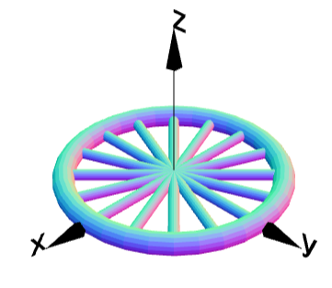
Wheel with more spokes

Slide 12
Wheel with more spokes
wheel = torus(1,0.1);
spoke = cylinder(0.05,2);// position first object
for (i=1; i<=8; i=i+1){// start for loop
wheel = wheel.add(spoke);// add
wheel.rotateZ(22.5);// then rotate
}
wheel.display();

