Slide 1
Printable Programming Good Coding Practice

Slide 2
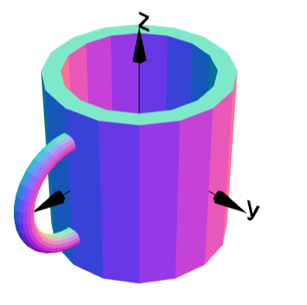
Example: Mug
g1 = cylinder(0.4,0.7).moveY(0.2);
g2 = cylinder(0.5,1.0);
g3 = torus(0.3,0.05).moveX(0.5);
g4 = g2.add(g3);
g4 = g4.subtract(g1);
g4.rotateX(90);
g4.display();
Code works fine, but …
How to change thickness of handle?
How to change thickness of cup?
Code is hard to understand and modify

Slide 3
Big Projects
"w" => "[0-9]+%?", "h" => "[0-9]+%?", "x" => "[0-9]+", "y" => "[0-9]+", "t" => "jpg|png", "q" => "1?[0-9]{1,2}" ); // check tags and save correct values in array for ($i=0; $i if (isset($check[$matches[$i][2]])) { if (preg_match('/^('.$check[$matches[$i][2]].')$/', $matches[$i][3])) { $tags[$matches[$i][2]] = $matches[$i][3]; } } } function notfound() { header("HTTP/1.0 404 Not Found"); exit; } // check that filename is given if (!isset($tags["f"])) { notfound(); } // check if file exists if (!file_exists($base_img_dir.$tags["f"])) { notfound(); } // retrieve file info $imginfo = getimagesize($base_img_dir.$tags["f"]); // load image switch ($imginfo[2]) { case 2: // jpg $img_in = imagecreatefromjpeg($base_img_dir.$tags["f"]) or notfound(); if (!isset($tags["t"])) { $tags["t"] = "jpg"; } break; case 3: // png $img_in = imagecreatefrompng($base_img_dir.$tags["f"]) or notfound(); if (!isset($tags["t"])) { $tags["t"] = "png"; } break; default: notfound(); } // check for maximum width and height if (isset($tags["x"])) { if ($tags["x"] < imagesx($img_in)) { $tags["w"] = $tags["x"]; } } if (isset($tags["y"])) { if ($tags["y"] < imagesy($img_in)) { $tags["h"] = $tags["y"]; } } // check for need to resize if (isset($tags["h"]) or isset($tags["w"])) { // convert relative to absolute if (isset($tags["w"])) { if (strstr($tags["w"], "%")) { $tags["w"] = (intval(substr($tags["w"], 0, -1)) / 100) * $imginfo[0]; } } if (isset($tags["h"])) { if (strstr($tags["h"], "%")) { $tags["h"] = (intval(substr($tags["h"], 0, -1)) / 100) * $imginfo[1]; } } // resize if (isset($tags["w"]) and isset($tags["h"])) { $out_w = $tags["w"]; $out_h = $tags["h"]; } elseif (isset($tags["w"]) and !isset($tags["h"])) { $out_w = $tags["w"]; $out_h = $imginfo[1] * ($tags["w"] / $imginfo[0]); } elseif (!isset($tags["w"]) and isset($tags["h"])) { $out_w = $imginfo[0] * ($tags["h"] / $imginfo[1]); $out_h = $tags["h"]; } else { $out_w = $tags["w"]; $out_h = $tags["h"]; } // new image in $img_out $img_out = imagecreate($out_w, $out_h); imagecopyresized($img_out, $img_in, 0, 0, 0, 0, imagesx($img_out), imagesy($img_out), imagesx($img_in), imagesy($img_in)); } else { // no resize needed $img_out = $img_in; } // check for a given jpeg-quality, otherwise set to default if (!isset($tags["q"])) { $tags["q"] = 75; } // returning the image switch ($tags["t"]) { case "jpg": header("Content-type: image/jpeg"); imagejpeg($img_out, "", $tags["q"]); exit; case "png": header("Content-type: image/png"); imagepng($img_out); exit; default: notfound();
Impossible to understand!

Slide 4
Tips
Use Comments and good variable names:
Code easy to follow
Easily to edit code

Slide 5
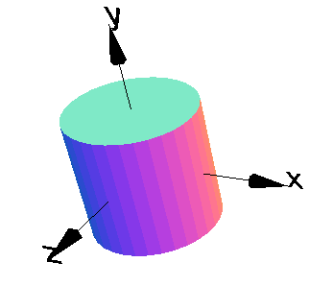
Numbers
g = cylinder(1,2,32);
g.display();
Numbers 1,2 and 32 are hard to understand.

Slide 6
Naming Numbers
Name them “radius,” “height” and “quality”
radius = 1;
height = 2;
quality = 32
g = cylinder(radius,height,quality);
g.display();

Slide 7
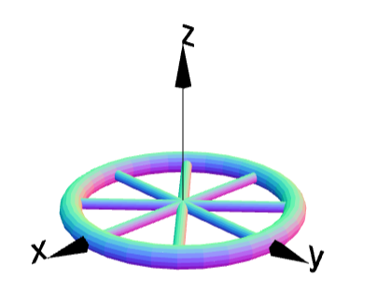
Wheel
g = torus(1,0.1);
g1 = cylinder(0.05,2);
g2 = cylinder(0.05,2).rotateZ(45);
g3 = cylinder(0.05,2).rotateZ(90);
g4 = cylinder(0.05,2).rotateZ(135);
g = g.add(g1).add(g2).add(g3).add(g4);
g.display();
Object names g, g1, g2 … not a great choice

Slide 8
Naming objects
wheel = torus(1,0.1);
spoke1 = cylinder(0.05,2);
spoke2 = cylinder(0.05,2).rotateZ(45);
spoke3 = cylinder(0.05,2).rotateZ(90);
spoke4 = cylinder(0.05,2).rotateZ(135);
finalWheel = wheel.add(spoke1).add(spoke2);
finalWheel = finalWheel.add(spoke3).add(spoke4);
finalWheel.display();
Using appropriate names for objects

Slide 9
Naming objects and numbers
wheelRadius = 1;
wheelThickness = 0.1;
spokeLength = 2;
spokeRadius = 0.05;
wheel = torus(wheelRadius, wheelThickness);
spoke1 = cylinder(spokeRadius, spokeLength);
spoke2 = cylinder(spokeRadius, spokeLength).rotateZ(45);
spoke3 = cylinder(spokeRadius, spokeLength).rotateZ(90);
spoke4 = cylinder(spokeRadius, spokeLength).rotateZ(135);
finalWheel = wheel.add(spoke1).add(spoke2);
finalWheel = add(spoke3).add(spoke4);
finalWheel.display();
Code is longer but easier to understand

Slide 10
Dependent numbers
wheelRadius = 1;
wheelThickness = 0.1;
spokeLength = 2*wheelRadius;
spokeRadius = wheelThickness/2;
wheel = torus(wheelRadius, wheelThickness);
spoke1 = cylinder(spokeRadius, spokeLength);
spoke2 = cylinder(spokeRadius, spokeLength).rotateZ(45);
spoke3 = cylinder(spokeRadius, spokeLength).rotateZ(90);
spoke4 = cylinder(spokeRadius, spokeLength).rotateZ(135);
finalWheel = wheel.add(spoke1).add(spoke2);
finalWheel = add(spoke3).add(spoke4);
finalWheel.display();
Use minimum number of variables

Slide 11
Comments
Purpose of Comments
Adds clarity to your code
Allows you to look up lines of code easily
To add a comment:
Simply add // after your code
Follow this by your comment
Comments do not affect the actual code

Slide 12
Comments
Example: Simple Cylinder
radius = 1.0; //radius of cylinder
height = 2.0; //height of cylinder
g = cylinder(radius,height,32); //creates cylinder g
g.display(); //displays cube
Good Comment Practice
Keep your comments short and to the point
Comment any line which needs clarity

Slide 13
Example: Mug
g1 = cylinder(0.4,0.7).moveY(0.2);
g2 = cylinder(0.5,1.0);
g3 = torus(0.3,0.05).moveX(0.5);
g4 = g2.add(g3);
g4 = g4.subtract(g1);
g4.rotateX(90);
g4.display();
Name the objects
Name the variables
Add comments

